Slide 1
IMPLEMENTATION OF Language Identification
Amit ChowdhUry
Rohit phadke
Balaji dange
UNDER THE GUIDANCE OF
Prof. Gajanan birajdar

Slide 2
Language Identification
The process of identifying the language that is being spoken by a speaker.
There are around 22 major languages and over 860 languages spoken in India.
Whereas 7,097 languages spoken around the world. [5]
Hence in such multi-lingual society, it is essential to recognize a spoken language

Slide 3

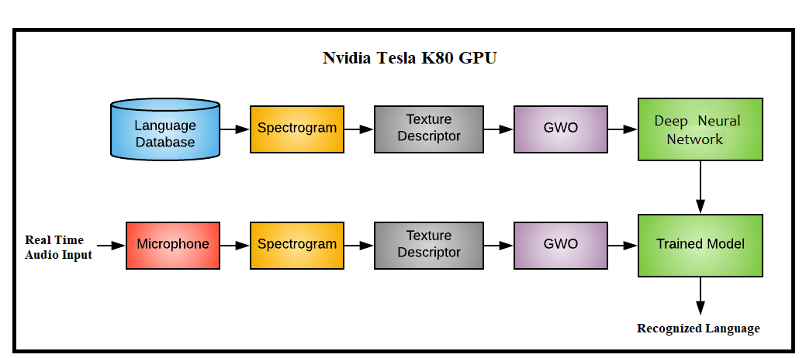
Proposed ALGORITHM

Slide 4
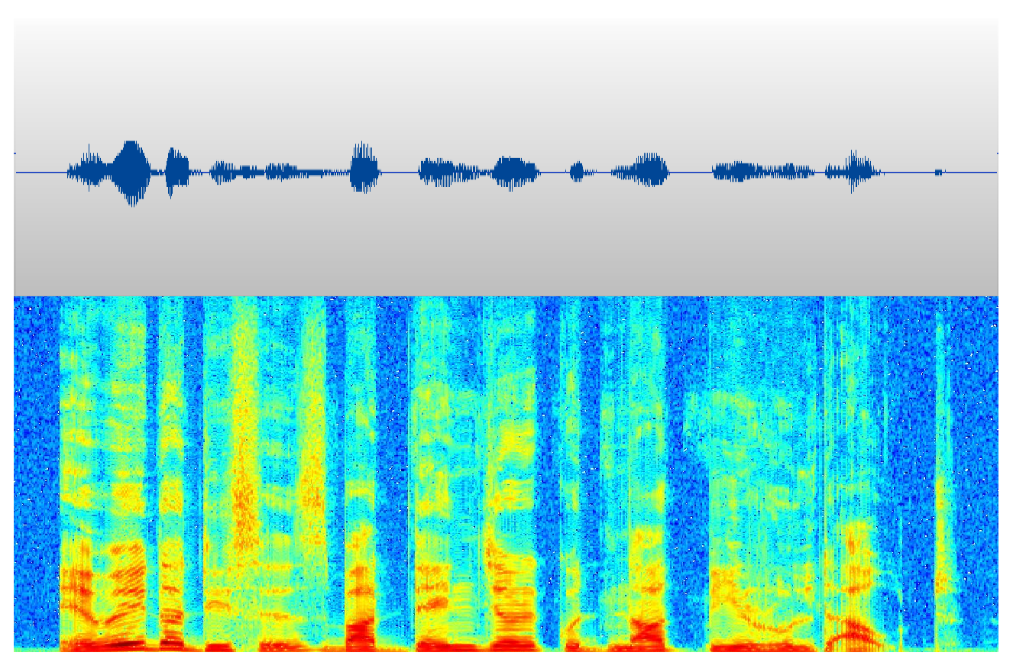
Spectrogram
Visual representation of the spectrum of frequencies.
Signal varies with respect to time.
Frequency
Time

Slide 5

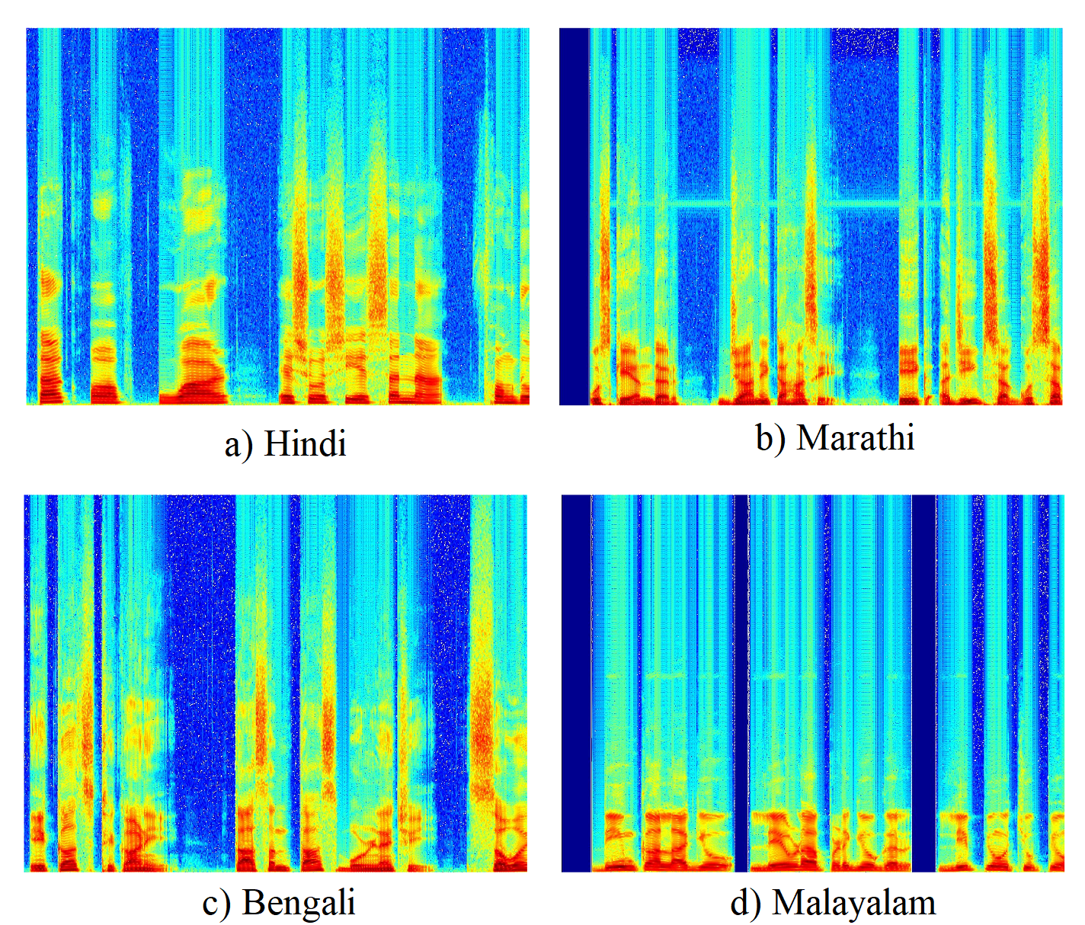

Slide 6
RICLBP [3]
Rotation invariant co-occurrence among adjacent LBPs (RICLBP) is a local feature descriptor.
Use to extract the texture features of the spectrogram image.

Slide 7
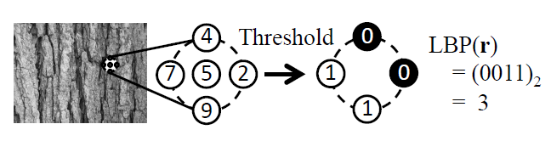
LBP :
Binary pattern obtained by the difference between a center pixel and its neighboring pixels.

Slide 8
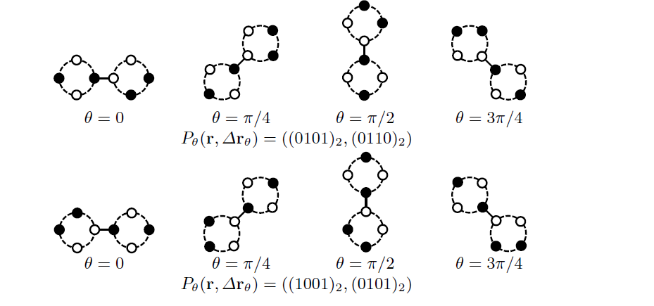
RICLBP [3]
The original LBP does not preserve structural information among binary patterns.
To achieve a high descriptive ability and rotation invariance, we incorporate rotation invariance into LBP pair.

Slide 9
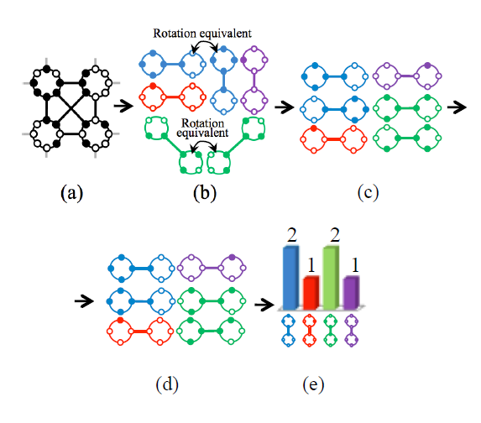

Slide 10
Feature Selection : GWO [7]
The Grey Wolf Optimization algorithm mimics the leadership hierarchy and hunting mechanism of grey wolves in nature.
Four types of grey wolves such as :-
Alpha
Beta
Delta
Omega

Slide 11
Feature Selection
A feature selection algorithm can be seen as the combination of a search technique for proposing new feature subsets, along with an evaluation measure which scores the different feature subsets.
Feature Selection is an efficient data preprocessing technique used for multimedia data retrieval.
After applying GWO Algorithm to the combined feature vector the feature size reduces from 136 to 83.

Slide 12
Deep learning:-
Deep learning is an aspect of artiﬁcial intelligence associated with the emulation of a learning method that people use to acquire certain knowledge.
Simply, deep learning can be perceived as a way to automate predictive analysis.
Deep Neural Network Model:
Input Layer : Dense = 83 , Activation function = Relu
Hidden Layer 1 : Dense = 64 , Activation function = Relu
Hidden Layer 2 : Dense = 32 , Activation function = Relu
Hidden Layer 3 : Dense = 16 , Activation function = Relu
Output Layer : Dense = 4 , Activation function = Softmax

Slide 13

Experimental Result
Input Language (No. of samples) | Output Language (No. of samples) |  |  |  | Accuracy (%)
 | Hindi | Marathi | Bengali | Malayalam
Hindi (300) | 291 | 0 | 6 | 3 | 97.00%
Marathi (300) | 0 | 300 | 0 | 0 | 100.00%
Bengali (300) | 4 | 0 | 296 | 0 | 98.67%
Malayalam (300) | 2 | 0 | 0 | 298 | 99.33%
Overall Accuracy |  |  |  |  | 98.75%

Slide 14
Results obtained without feature selection
Input Language (No. of samples) | Output Language (No. of samples) |  |  |  | Accuracy (%)
 | Hindi | Marathi | Bengali | Malayalam
Hindi (300) | 268 | 3 | 21 | 8 | 89.33%
Marathi (300) | 4 | 293 | 0 | 3 | 97.67%
Bengali (300) | 16 | 0 | 283 | 1 | 94.33%
Malayalam (300) | 9 | 1 | 1 | 289 | 96.33%
Overall Accuracy |  |  |  |  | 94.42%

Slide 15
Applications of lid :-
Natural language processing system.
Multilingual spell check.
Pre-processing step for any translation Engines.
Document filtering system.

Slide 16
Conclusion :-
We have proposed an algorithm to recognize an unknown language in real time.
The frequency band for every language is different from each other and it follows certain pattern for each and every language.
The performance of the model is enhanced by using GWO.
We have achieved an accuracy of 98.75% using this approach.

Slide 17
References :-
I. Guyon, A. Elisseeff, "An introduction to variable and attribute selection". The Journal of Machine Learning Research; 2003; 3: 1157-1182.
Emary, E., Waleed Yamany, Aboul Ella Hassanien, and Vaclav Snasel. "Multi-Objective Gray-Wolf Optimization for Attribute Reduction", Procedia Computer Science, 2015..
Nosaka R, Fukui K. HEp-2 cell classification using rotation invariant co-occurrence among local binary patterns. Pattern Recognit. Elsevier; 2014;47: 2428–2436.
Manish Kumar Rai, Neetish, and Md. S. Fahad, Jainath Yadav and K. Sreenivasa Rao `` Language Identification Using PLDA Based on I-Vector in Noisy Environment'', Int. Conf. on Advances in Computing, Communications and Informatics, pp.1014-1020, 2016.
https://www.ethnologue.com Accessed on 3 August, 2018.

Slide 18
Jyotsana Bal leda, Hema A Murthy, and T.Nagarajan, “Language identification from short segments of speech”, Sixth Int. Conf. on Spoken Language Processing, Vol.3, pp.1033-1036, 2000.
Bakshi Aarti, Sunil Kumar Kopparapu. " Spoken Indian Language Classification Using ANN and Multi-Class SVM", 2018 International Conference On Advances in Communication and Computing Technology (ICACCT), 2018.
www.nvidia.in/object/tesla-k80-dual-gpu-accelerator-oct-14-2014-in.html Accessed on December 2018.
Seyedali Mirjalili, Seyed Mohammad Mirjalili, and Andrew Lewis, “Grey Wolf Optimizer”.

Slide 19

THANK YOU !!!

